Slide 1
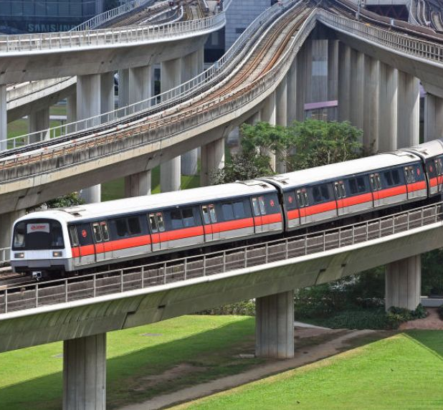
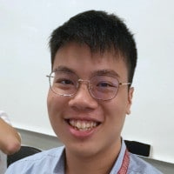

Mass Rapid Transit System Line Simulation
Team 14
Lee Min Shuen
Samuel Sim Wei Xuan
40.015 Simulation Modeling and Analysis | Term 06 2021

